Slide 1
TEAM INTELLIGENCE
Midterm Presentation
Gradient
2023.11.10

Slide 2
INDEX
Member roles
Timeline
UI/UX
Implementations
Challenge
Limitation
Milestone
Expectation

Slide 3
Member roles
규원
준형
영우
영준
Frontend
Design
Frontend
Backend
Frontend
Backend

Slide 4
Timeline
Text Input Phase UI Development
영우
10/27 ~ 11/10
Backend Processing and integration with Chat-GPT
영준
Calander Page Development
and extract feelings
규원, 준형
Color Selection Function
준형
11/10 ~ 11/24
Connect with Instagram API for sharing
규원, 영준
Google social login function
영우

Slide 5
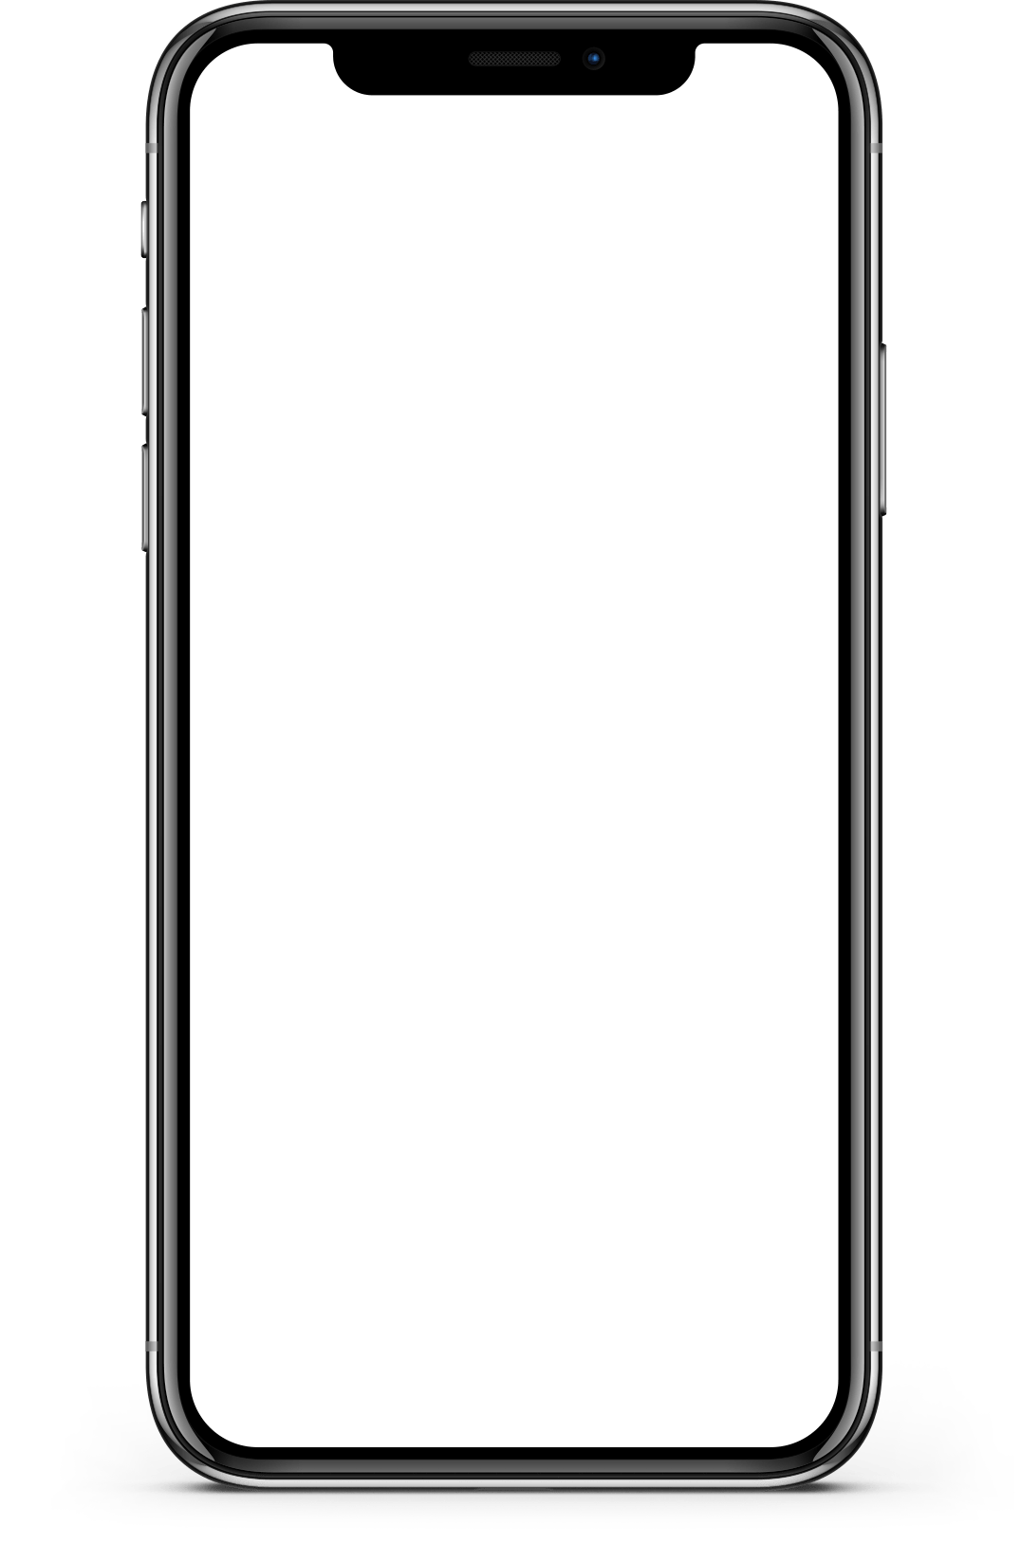
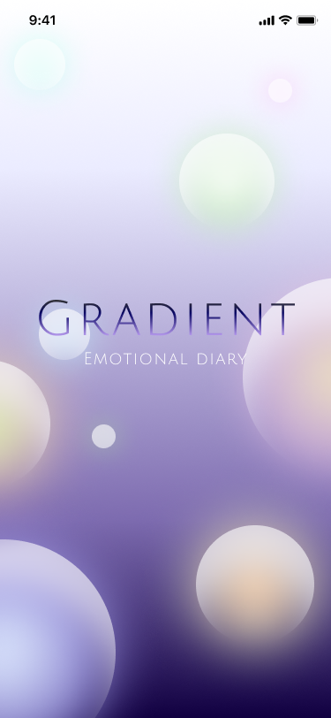
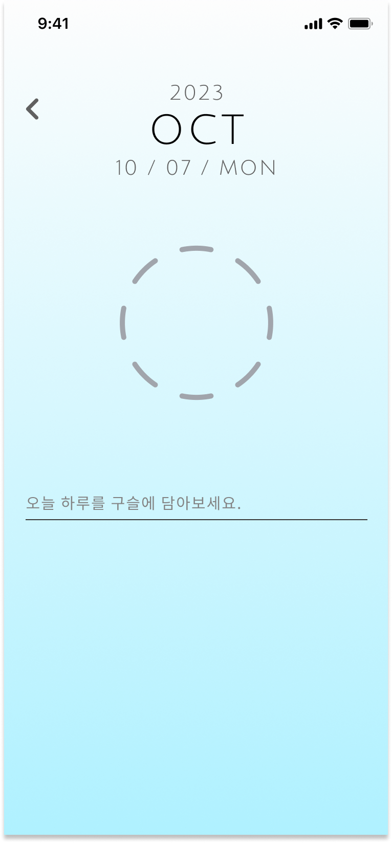
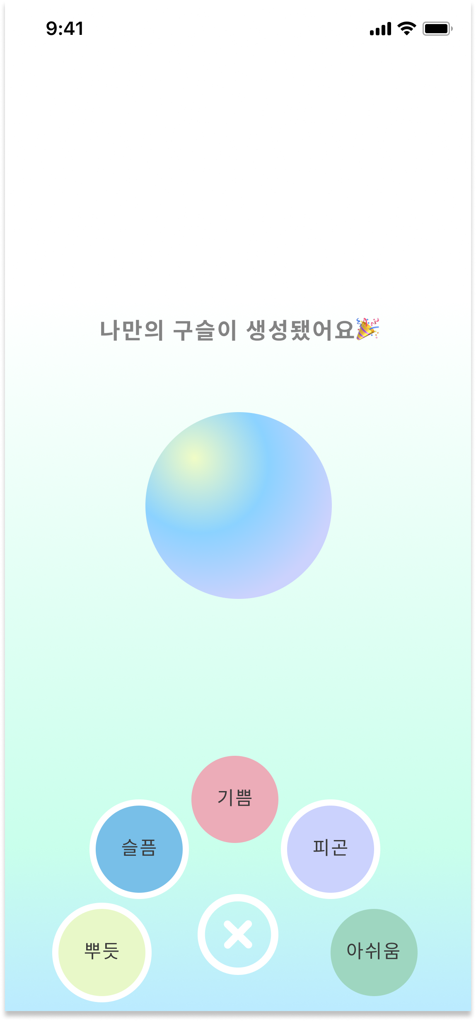
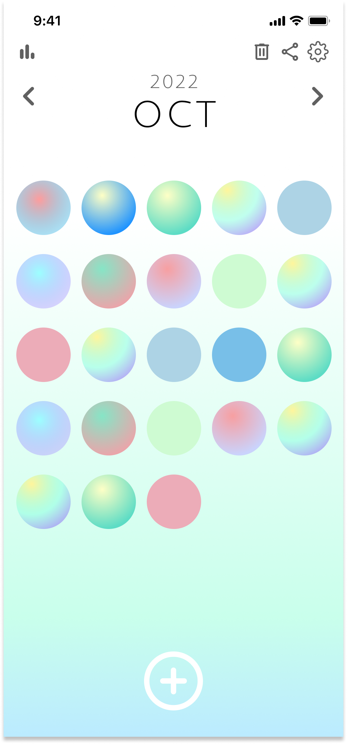

UI/UX

Slide 6
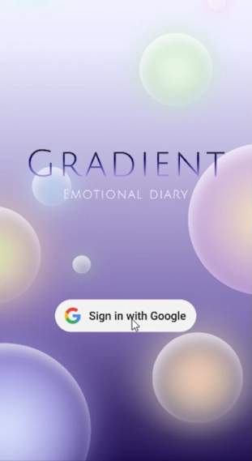
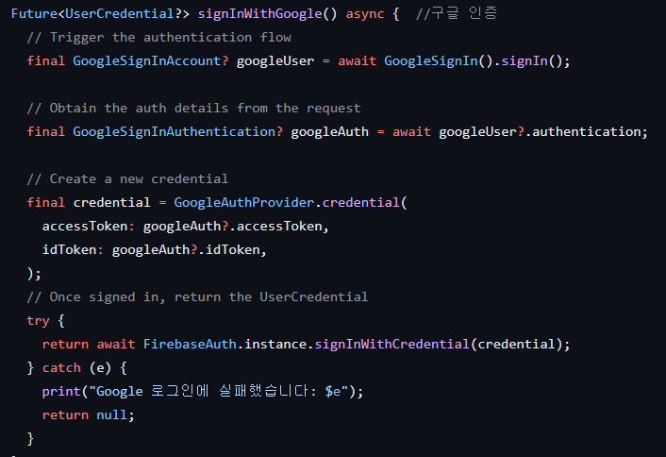
Implementation
: Google Social Login Function

Slide 7
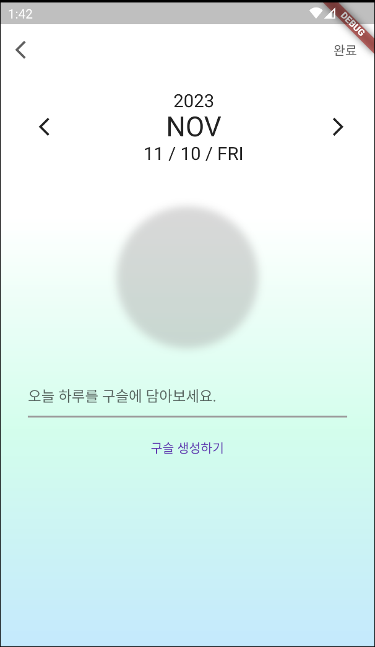
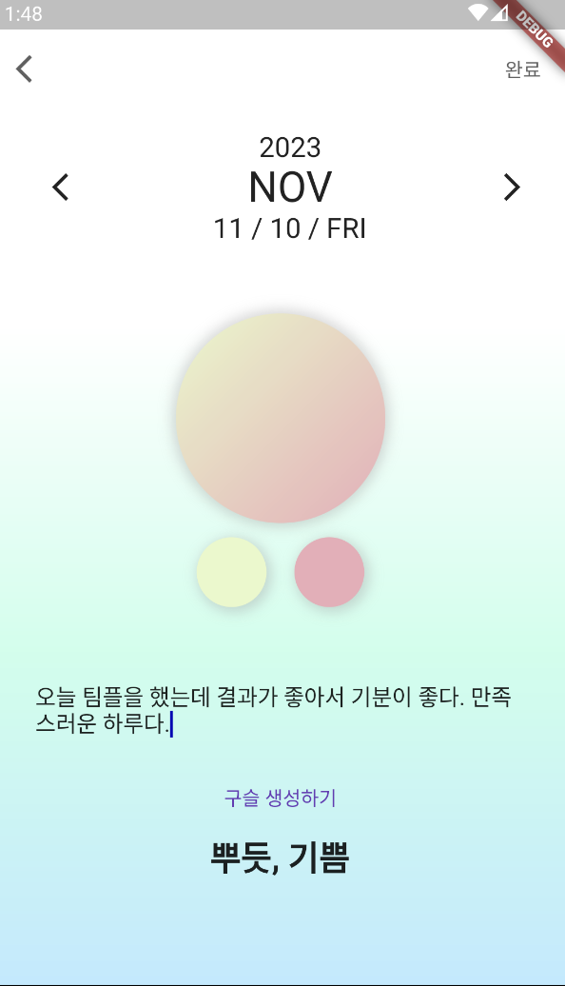
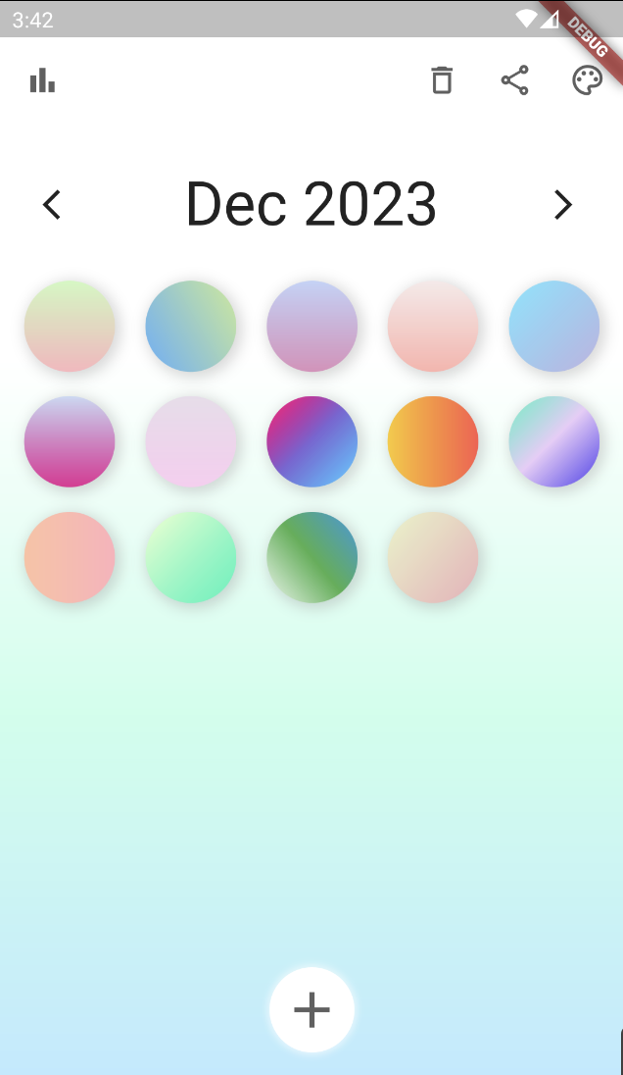
Implementation
: Text Input Phase & UI Development

Slide 8

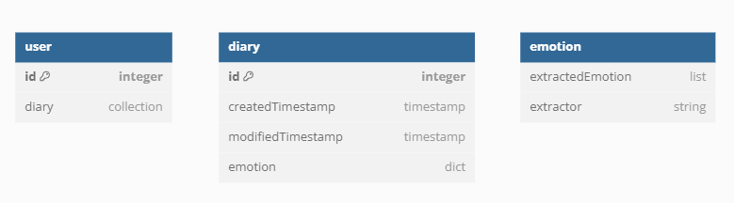
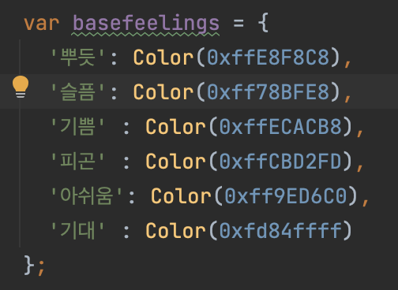
Implementation
: Backend Processing and integration with Chat-GPT
Color Database
https://github.com/jjh946/gradient3/blob/yj/lib/extract_emotion.dart
제 브랜치에 프롬프트 엔지니어링 개선 + 모델 버전 변경한 ChatGPT API 사용 테스트 (Run하면 stdout에 출력)코드 파일 업로드 해두었습니다!
https://pub.dev/packages/http/install
로 http 패키지 설치하고 구동하니까 정상작동합니다 (변경되는 파일이 많고, dark flutter에서 gitignore 설정을 잘 몰라서 일단 패키지 설정 포함하여 push하지는 않았습니다)
Request
Response
{"diary": "오늘은 학교에서 프로젝트를 했다. 뿌듯하지만 아직 할 것이 산더미라 조금 슬프다. 언젠가 다 하겠지? 피곤해서 오늘은 일찍 자야지."}
'A: 뿌듯함, 슬픔, 피곤함'

Slide 9
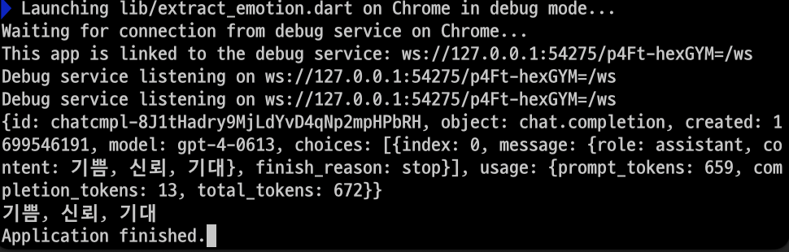
Implementation
: Backend Processing and integration with Chat-GPT
Decoding GPT’s response to JSON
Return Emotions from JSON
Display colors of extracted emotion

Slide 10
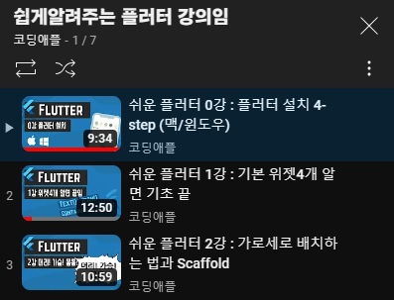

Challenge
: Different Background
규원, 영우
No App Development Experience
Difference of Flutter Version

Slide 11

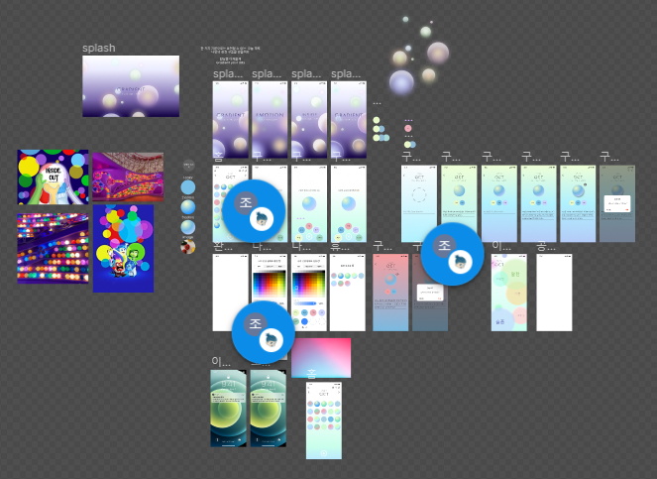
Challenge
: Using Figma
Problem
Hard to decide what to do first.
Hard to make specific design.
Solutions
1. Due to UI/UX, we can save time and decide flow of the development.
2. Figma provides various basic design.

Slide 12




Challenge
: Using Packages
It is hard to fix or change object in packages

Slide 13
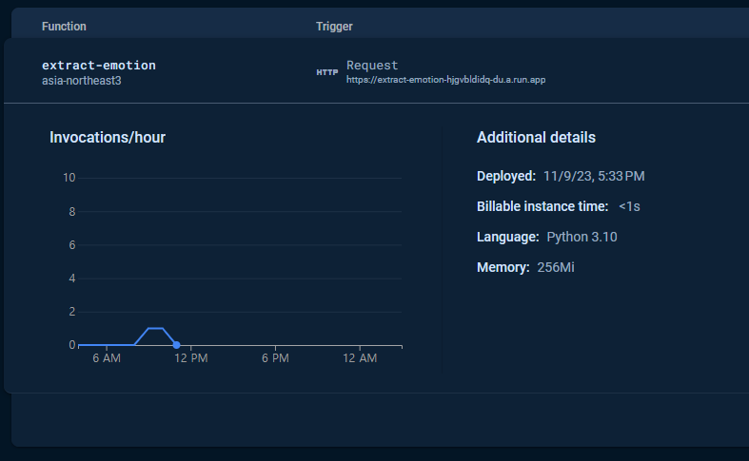
Implementation
: Backend Processing and integration with Chat-GPT
Text Input From User
구슬 생성하기
HTTP post request
Send Pre-made Prompt and
Send User’s text
Receive Extracted Emotions from GPT by using function

Slide 14
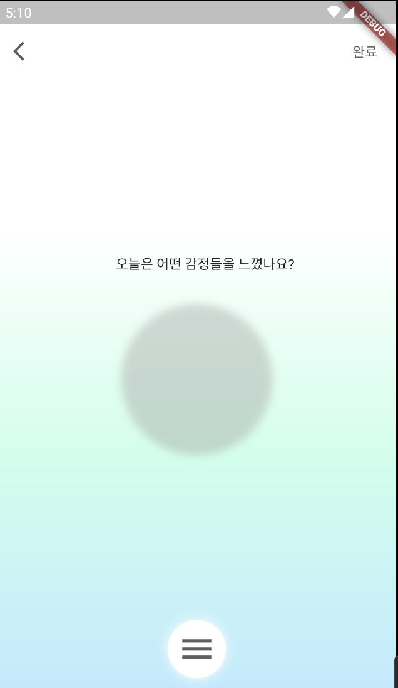
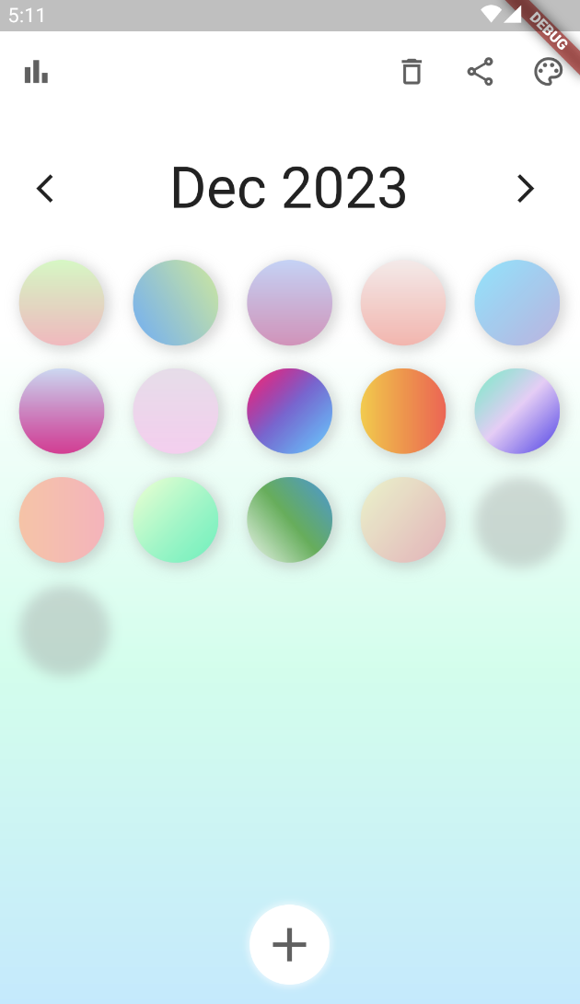
Challenge
: Express Empty Beads
To deal with fact-based or no emotion case,
Make beads as circular containers and express as box shadow
No shadow in UI/UX

Slide 15
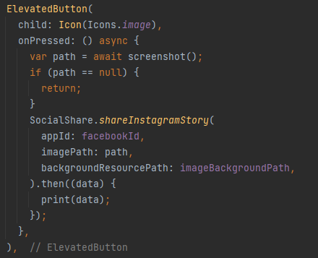
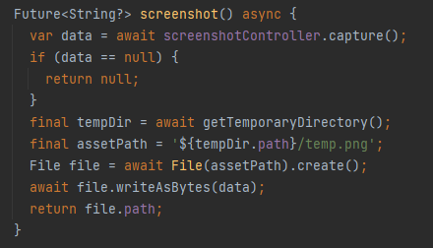
Challenge
: Connect with Instagram API for sharing
Absence of Official API -> Find another one (social_share)
: Hard to find references
Make Screenshot Image for Sharing
Connect Application to Instagram

Slide 16



Limitation
: Can GPT distinguish who felt the emotion?
Q. There was a friend who I don’t like. And I saw him happy to win the lottery yesterday. I thought I wanted to win the lottery, too. I'm sure I'll make it. Let's study hard again today. Fighting!
[GPT 3.5]
A: Happiness, Envy,
Expectation
[GPT 4]
A: Hate, Envy, Trust

Slide 17
Milestone
Color Selection Function and Database
준형, 영준
11/10 ~ 11/24
Connect with Instagram API for sharing
규원
Calander Page
영우
Add Feelings & Diary Modifying
준형, 영준
11/25 ~ 12/8
Beautify Design
규원
Making UI for fact-based text
영우

Slide 18
Milestone
12/8~12/15
Counseling Function
준형, 영준
Debugging, Prepare for uploading to PlayStore
규원, 영우

Slide 19




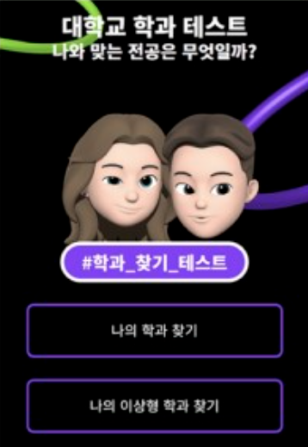



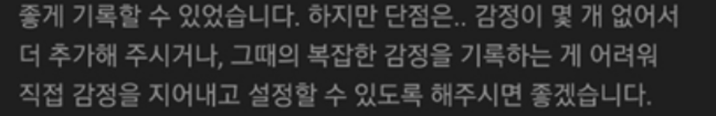
Expectation

Slide 20
Q&A

